Slide 1
Joint Tutorial
IEEE 802.3br
TF Interspersing express traffic (IET)
Ludwig Winkel, Siemens AG and
IEEE 802.1 Time sensitive Networking (TSN)
Michael Johas Tenner, Broadcom
IEEE 802.1 / IEEE 802.3 Tutorial #2,
March, 2015
Berlin, Germany

Slide 2
Title and presenters
TITLE OF TUTORIAL:
Real-time Ethernet on IEEE 802.3 Networks
NAME OF PRESENTERS, THEIR AFFLIATIONS AND CONTACT INFO:
Presenter(s) Name: | Affiliation: | Email Address:
Ludwig Winkel | Siemens | Ludwig.Winkel@Siemens.com
Michael J.Teener | Broadcom | mike@JOHASTEENER.COM
Norm Finn | Cisco | nfinn@CISCO.COM
Pat Thaler | Broadcom | pthaler@broadcom.com
Panelists
Albert Tretter | Siemens | albert.tretter@siemens.com
Stephan Kehrer | Hirschmann (Belden) | Stephan.Kehrer@belden.com
Christian Boiger | b-plus GmbH | christian.boiger@b-plus.com
David Brandt | Rockwell Automation | ddbrandt@ra.rockwell.com
Helge Zinner | Bosch | Helge.Zinner@de.bosch.com

Slide 3
Abstract
There have been multiple networks based on propriety technology or specialized standards developed to support carrying highly time sensitive traffic for applications such industrial automation and automotive control. Some of these are modified Ethernet networks. The efforts in IEEE 802.1 Time Sensitive Networking and P802.3br Interspersing Express Traffic provide an example of bringing together the requirements of those applications to provide a standard network that can support traffic requiring deterministic delivery time for real-time communication along with traditional traffic. This tutorial will cover the fundamentals of the projects and how they work together to fulfill the requirements of the various verticals.

Slide 4
Agenda
Welcome, Introduction (Michael, Ludwig) 5min
Recap of Geneva Tutorial (Ludwig) 5min
Project time lines (Michael, Ludwig) 5min
Architectural Options/System Overview (Norm) 30min
  Enhancing IEEE 802.1Q tool set
Interspersing Express Traffic (Pat) 30min
  Preemption for Ethernet
Conclusion,Q&A/Discussion (Michael, Ludwig) 15min

Slide 5
Recap of Geneva Tutorial
Presented by Ludwig or Mike

Slide 6
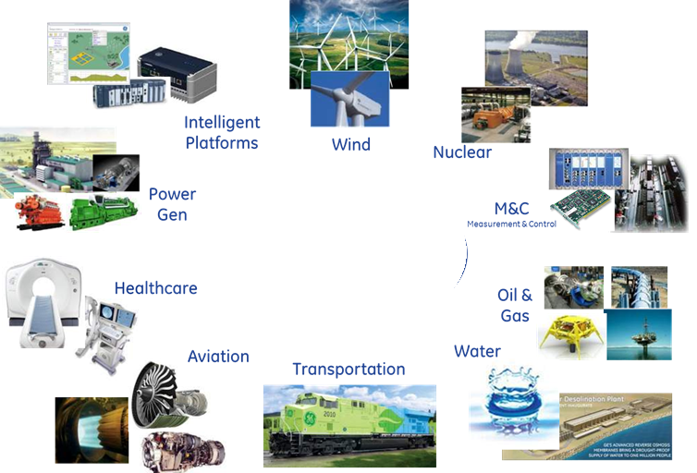

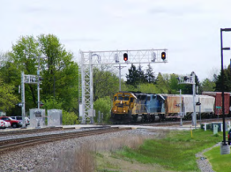

Potential Markets Served by IET
Industrial
Automation
High Traffic Mix, Deterministic, Low Latency, Secure, Reliable, High Throughput
Asset
Optimization

Slide 7
Control Function and Network Complexity Progression
Virtualization
Network Complexity
Network
Fabrics
Functional Complexity
Discrete
Controls
Era
Networked
Controls
Era
Sensor/Actuator
Networks
Functional Complexity
Cloud
Architecture
Era
Time Line
2013
Control Systems in all market sectors perpetually increase in functional complexity.
Communications complexity limits functional capability.
Advanced communications architectures enable advances in controls.

Slide 8
Application Protocols for Control
Transportation
ARINC 664
Flexray
Distribution
IEC 61850
IEC 60870
DNP 3.0
Industrial
Modbus TCP
OPC
Profinet
Foundation Fieldbus HSE
Motion
Ethercat
Powerlink
Profinet IRT
SynqNet
SERCOS III
Ethernet/IP
AS6802 (TTE)
CAN
MOST
IEEE 1588
NTP
Note: There are many other proprietary protocols not on this list
Notes:
New information., color with degree of alignment. (red, yellow, green), add the info that there are an entire family of non-ethernet protocols
Mark as key message slide

Slide 9
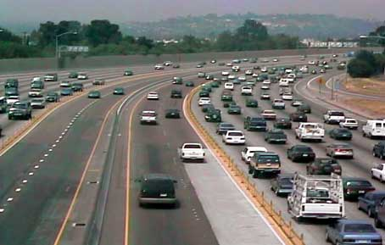
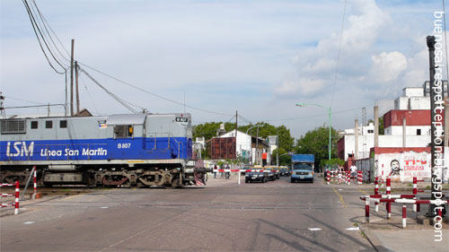
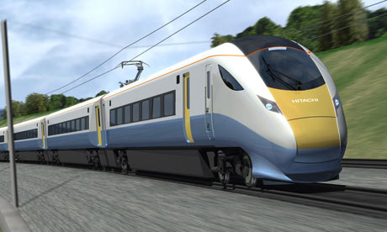
Why Converged Traffic Networks
Minimizing
Interference
T1
High
low
T2
T1
Slot
None time slotted traffic
T2
Slot
Time Cyclic
Control Traffic
None Real time Traffic
Logging
Alerting
Real time – non cyclic Traffic
Critical Alarms
Discrete/event control

Slide 10
Why one single Network for all Communication Services
Only one network means:
  Reduced possibility of network failures
    wire breaks, reduced confusion in case of maintenance
  Reduced installation costs
    fewer cables and connectors, lower installed costs and faster startups
  Enables smaller devices
    reduced space for connectors, lower power consumption (only half the number of PHYs needed)
  Reduced maintenance costs
    easier to understand and to maintain, less personnel training
  Only one interface in the devices
    only one MAC address, only one IP address, easier to understand and to maintain, easier coordination of the communication relations in the stack and application layer in the devices, more direct access to data.

Slide 11
Summary: Industrial Requirements for Interspersed Traffic
Performance requirements for Interspersed Traffic:
Minimum latency: < 3µsec max per hop accumulated latency (GE – min frame)
Guaranteed latency, low jitter
Topology independent
Typical data size (payload size): 40 - 300 bytes
Range of transmission period: 31.25µs – 100ms and aperiodic
Scheduled Traffic & Alarm has higher priority than Reserved Traffic and Best Effort Traffic
Low cost, Low power, Low complexity
* These are our best estimates derived from multiple use cases of the current and future industrial applications.

Slide 12
Main Benefits of IET
Better network utilization for scheduled traffic (More capacity).
Lower latency for High Priority, critical asynchronous (non-scheduled) traffic.
Lower cost and power consumption (for equivalent performance).
Better environmental characteristics.

Slide 13
Project time lines, Work plan
Work plan IEEE 802-3br:
  TF review in Dec 2014 done
  WG ballot in March 2015
  Publication in 1Q/2016
Work plan IEEE 802-1Qbu:
  TG review in Sep 2014
  WG ballot in Jan 2015
  Publication in Sep 2015

Slide 14
Architectural options / system overview
Who, What, Why, How
Norman Finn

Slide 15
What is Time-Sensitive Networking?
Same as normal networking, but with the following features for critical data streams:
Time synchronization for network nodes and hosts to better than 1 µs.
Software for resource reservation for critical data streams (buffers and schedulers in network nodes and bandwidth on links), via configuration, management, and/or protocol action.
Software and hardware to ensure extraordinarily low packet loss ratios, starting at 10^{–6} and extending to 10^{–10} or better, and as a consequence, a guaranteed end-to-end latency for a reserved flow.
Convergence of critical data streams and other QoS features (including ordinary best-effort) on a single network, even when critical data streams are 75% of the bandwidth.

Slide 16
Who needs Time-Sensitive Networking?
Two classes of bleeding-edge customers, Industrial (including in-automobile) and Audio/Video. Both have moved into the digital world, and some are using packets, but now they all realize they must move to Ethernet, and most will move to the Internet Protocols.
Industrial: process control, machine control, and vehicles.
  At Layer 2, this is IEEE 802.1 Time-Sensitive Networking (TSN).
  Data rate per stream very low, but can be large numbers of streams.
  Latency critical to meeting control loop frequency requirements.
Audio/video: streams in live production studios.
  At Layer 2, this is IEEE 802.1 Audio Video Bridging (AVB).
  Not so many flows, but one flow is 3 Gb/s now, 12 Gb/s tomorrow.
  Latency and jitter are important, as buffers are scarce at these speeds.
(You won’t find any more market justification in this deck.)

Slide 17
Why such a low packet loss ratio?
Back-of-the-envelope calculations for big networks:
Industrial:
  Automotive factory floor: 1000 networks • 10000 packets/s/network •
  100,000 s/day = 10¹² packets/day.
  Machine fails safe when 2 consecutive packets of a stream are lost.
  At a random loss ratio of 10^{–6}, 10^{–12} is chance of 2 consecutive losses.
  10¹² packets/day • 10^{–12} 2-loss ratio = 1 production line halt/day.
  In extreme cases, lost packets can damage equipment or require expensive measures to protect people.
Audio video production: (not distribution)
  10¹⁰ b/s • 10 processing steps • 1000 s/show = 10¹⁴ bits = 10¹⁰ packets.
  Waiting for ACKs and retries = too many buffers, too much latency.
  Lost packets result in a flawed master recording, which is the user’s end product.

Slide 18
How such a low packet loss ratio?
Zero congestion loss.
  This requires reserving resources along the path. (Think, “IntServ” and “RSVP”) You cannot guarantee anything if you cannot say, “No.”
  This requires hardware in the form of buffers, shapers, and schedulers. Overprovisioning not useful: its packet loss curve has a tail.
  Circuits only scale by aggregation in to larger circuits. ( MPLS? Others?)
  0 congestion loss goes hand-in-hand with finite guaranteed latency.
Seamless redundancy.
  1+1 redundancy: Serialize packets, send on 2 (or more) fixed paths, then combine and delete extras. Paths are seldom automatically rerouted.
  0 congestion loss means packet loss is failed equipment or cosmic rays.
  Zero congestion loss satisfies some customers without seamless redundancy. The reverse is not true in a converged network—if there is congestion on one path, congestion is likely on the other path, as well.

Slide 19
Why all the fuss? You could just …
Old-timers remember the fuss 1983-1995 about Ethernet vs. Token Bus, Token Ring, and other “more deterministic” versions of IEEE 802 wired media. Ethernet won. One could argue that this TSN stuff sounds like the same argument. So, what’s different besides, “That was then, this is now”?
TSN stays within the 802.1/802.3 paradigm.
Applications are more demanding of the network, now.
No IEEE 802 medium entirely captured the real-time control applications that drive the present effort—they went to non-802 (including non-packet) answers.
Yes, Voice over IP works pretty well—except when it doesn’t. That’s a non-starter for these users.
Too much data to overprovision.

Slide 20
Queuing models

Slide 21
The IEEE 802.1Q Queuing Model
IEEE 802.1 has an integrated set of queuing capabilities.
There are several capabilities, most familiar to all.
The “integrated” part is important—the interactions among these capabilities are well-characterized and mathematically sound.

Slide 22
Priority queuing and weighted queuing
802.1Q-1998: Strict Priority
802.1Q-2012 (802.1Qaz) adds weighted queues. This standard provides standard management hooks for weighted priority queues without over-specifying the details.
1
0
2
3
4
5
6
7
Priority selection
Weighted
1
0
2
3
4
5
6
7
Priority selection

Slide 23
AVB shapers
802.1Q-2012 (802.1Qat) adds credit-based shapers . Shaped queues have higher priority than unshaped queues. The shaping still guarantees bandwidth to the highest unshaped priority (7).
The AVB shaper is similar to the typical run rate/burst rate shaper, but with really useful mathematical properties.
  Only parameter = bandwidth.
  The impact on other queues of any number of adjacent shapers Is the same as the impact of one shaper with the same total bandwidth.
Weighted
← Highest priority for shaped queues
1
0
4
5
6
7
2
3
Priority selection

Slide 24
Time-gated queues
802.1Qbv: A circular schedule of {time, 8-bit mask} pairs controls gates between each queue and the priority selection function.
Weighted
1
0
4
5
6
7
2
3
T
T
T
T
T
T
T
T
←Operated by a repeating schedule
Priority selection

Slide 25
Cyclic Queuing and Forwarding
802.1Qch: The 1Qbv time gated queues are used to create double buffers (two pairs, 2–3 and 4–5, shown in this example)
  If the wire length and bridge transit time are negligible compared to the cycle time, double buffers are sufficient.
←Shapers ensure fair access for 0, 1, 6, 7 traffic
1
0
6
7
2
3
4
5
T
T
T
T
T
T
T
T
←Alternately enable green and purple
Priority selection
Dead-time pad→
← Frames being received
For next cycle →
← Output in progress

Slide 26
Security and misbehavior
Security has traditionally been concerned with
  Privacy: Hiding the data from intruders
  Authentication: Ensuring that the data is not altered.
But now, proper operation depends upon the transmission timing, as well as the contents, of a packet.
The only difference between a malicious intruder and a software bug, misconfiguration, or hardware failure is intent, not result.
For example, a “babbling idiot” sending extra data on a TSN priority can cause the loss of packets from properly-behaving flows that share the same output queue.
Therefore, defense in depth is required to protect the network.

Slide 27
Per-stream filtering and policing
Applies to frames
coming up the stack,
not down.
G
G
G
G
G
G
G
G
G
G
G
Priority + circuit_identifier demux
The priority and packet flow ID (circuit_identifier) select to which Gate a frame is directed in P802.1Qci.
G
Each Gate can have:
  A pass / don’t pass switch. (May be time scheduled)
  A standard 802.1Q policing function.
  Counters of frames: e.g. passed, marked down, and discarded.
  A Service Class or priority output specifyer (TBD)
  Filters, e.g. max frame size.
0
0
1
0
0
1
P
0
0
1
0
0
1

Slide 28
Interspersed Express Traffic
Preempting a non-time-critical frame with a low-latency frame does get the low-latency frame out, sooner.
But, in many networks of interest, there are many conflicting low-latency frames—and the preemption of the non-time-critical frame only helps the first one.
Scheduling the time-critical frames’ transmission (P802.1Qbv) gives almost 0 jitter and guarantees end-to-end latency. These scheduled transmissions are the “rocks” around which a time-critical application is built.

Slide 29
Interspersed Express Traffic
IET is critical for convergence; non-scheduled does not mean “unimportant”.
Scheduled rocks of critical packets in each cycle:
Conflict excessively with non-guaranteed packet rocks:
Problem solved by preemptive sand between the rocks.
…
…
1
2
2
2
…
…
1
2
3
3

Slide 30
But wait! There’s more!
As a consequence of the above, you also get …
Cut-through forwarding: The scheduling tools mentioned, above, allow one to guarantee scheduled cut-through forwarding opportunities for predictable ultra-low-latency packets.
Intentional buffering delays: Time-scheduled transmissions can intentionally delaying transmissions in order to guarantee both a minimum and a maximum latency, thus minimizing jitter for the critical traffic. Industrial systems that trigger events based on packet reception require this.

Slide 31
Current IEEE 802 Status

Slide 32
IEEE 802 standards now and coming
802.1 Audio Video Bridging is now the Time-Sensitive Networking TG.
Time: A plug-and-play Precision Time Protocol (PTP) profile that allow bridges, routers, or multi-homed end stations to serve as “time relays” in a physical network, regardless of L2/L3 boundaries. (1AS complete, 1ASbt improvements in TG ballot)
Reservation: A protocol (MSRP) to reserve bandwidth along an L2 path determined by L2 topology protocol, e.g. ISIS. (1Qat complete, 1Qcc enhancements in TG ballot)
Execution: Several kinds of resources (shapers, schedulers, etc.) that can be allocated to realize the promises made by the reservation. (See next slides.)
Path distribution: ISIS TLVs to compute and distribute multiple paths through a network. (1Qca in sponsor ballot)
Seamless Redundancy: 1+1 duplication for reliability. (1CB in TG ballot)

Slide 33
IEEE 802 schedulers and shapers
AVB Credit-Based Shaper: Similar to the typical run rate/burst rate shaper, but with really useful mathematical properties. (1Qat done)
  Only parameter = bandwidth.
  The impact of any number of shapers = the impact of one shaper with the same total bandwidth.
Transmission preemption / express forwarding: Interrupt (1 level only) transmission of an Ethernet frame with a frame with tight latency requirements, then resume the interrupted frame. (3br, 1Qbu TG ballot)
Time scheduled: Every bridge port runs a synchronized, repeating schedule that turns on and off each of the 8 queues with up to nanosecond precision. (1Qbv WG ballot)
Synchronized Queuing and Forwarding: Every flow proceeds in lock-stepped transmission cycles, like arterial blood. (1Qch PAR approval)
Per-Stream Filtering and Policing: Packets accepted only from the right port only at the right time or at the right rate. (1Qci PAR approval)

Slide 34
Mixed L2/L3 need

Slide 35
Reference network
Controller
As seen by network
topology protocols
Physical
connectivity
Network sizes vary from
~home to ~large but within
one administrative domain.
Listener
La
L2
Talker
L2
Lc
T
MultiLink
subnet
L2
L3
Ld
routers
Bridges
Lb
Gazillions of complex protocols

Slide 36
Reference network
As seen by reliability/
queuing/latency/time
X
Physical
connectivity
Queue
Listener
Clock
La
Talker
Lc
T
Ld
Lb
Just nodes, queues, clocks, and wires!!

Slide 37
Summary
By means of resource reservation, via protocol, configuration, or net management, time-critical traffic can be guaranteed a low, finite end-to-end latency and extraordinarily low loss rate.
Preemption enables these guarantees to be made without sacrificing the ability of the network to carry “ordinary” traffic, and without compromising the promises made to time-critical traffic.
These features can, and should, work irrespective of L2/L3 boundaries, though of course, proper layering must be respected.

Slide 38
Interspersing Express Traffic
Preemption for Ethernet
Pat Thaler

Slide 39
IET Architecture
MAC Merge sublayer
  Capability discovery without negotiation
  Preserves frame integrity
  Is transparent to existing non-deprecated PHYs above 10 Mb/s
  Doesn’t change MAC operation
  Minimizes impact on throughput
  Provides lower latency for express traffic
  Provides cut-through for scheduled traffic
Queuing Frames
Transmission Selection
MAC Control
MAC Control
Express MAC
Preemptable MAC
MAC Merge Sublayer
PHY (unaware of preemption)

Slide 40
MAC Merge Sublayer

Slide 41
MAC Merge sublayer
Express MAC (eMAC)
Premptable MAC (pMAC)
Express Filter
Transmit Processing
Verification
Receive Processing
Physical Layer
Transmit processing arbitrates between eMAC and pMAC transmit packets and preempts if preemption capability is active.
Express filter sends express packets to eMAC
Receive Processing handles mPacket formats, checks fragments and sends to pMAC
Verification tests that the link can support preemption before preemption is activated

Slide 42
Preemption capability disabled
Express Filter
Transmit Processing
Verification
Receive Processing
Transmit processing
  eMAC packets have priority over pMAC packets
    They don’t preempt but if both have a frame ready to start, eMAC packet is sent.
  Preemptable mPacket formats aren’t used
Able to receive preemptable mPackets from link partner
  If link partner preemption capability isn’t active, all packets received by eMAC
Verification will respond to verify request from link partner

Slide 43
Preemption enabled, not active
Express Filter
Transmit Processing
Verification
Receive Processing
Verification function attempts to verify link preemption capability
  Transmits a verify mPacket
  Receipt of a response mPacket verifies the link and preemption capability can go active.
No change to Express Filter, Receive Processing or Transmit Processing

Slide 44
Why verify?
A link partner’s preemption capability is discovered through LLDP,
IEEE 802.1Q bridges don’t forward if the SA is nearest bridge group address, but …
Some non-standard devices (e.g. buffered repeaters) don’t block the address.
If such a device is between two ports, it may drop or alter the preemptable mPackets.
Verify tests that the link between to ports is able to carry preemptable mPacket formats.
Networks that are fixed by design (e.g. automotive networks) can disable verification.

Slide 45
Preemption Active
Express Filter
Transmit Processing
Verification
Receive Processing
mPackets
Transmit processing
  Uses mPacket formats
  Preempts preemptable packets if eMAC has a packet to send or for a HOLD request.
Verification responds to verify requests

Slide 46
Discovery and verification summary
Preemption capability independently activated on each end.
  Capability discovery – not negotiation.
Receiver is always ready for preemption
  Receive Processing and Express Filter behavior is the same regardless of whether preemption capability is active.
Link ability to support preemption is verified

Slide 47
MAC Merge Service Interface
Minimizing latency for scheduled traffic

Slide 48
Without Hold and Release
pMAC tx
eMAC tx
> Min mPacket left
MAC Merge tx
IPG
Preemption isn’t instantaneous.
Packets with less than min packet size left to transmit or packets less than 123 octets can’t be preempted.
In many use cases, this delay is short enough but not in all cases.

Slide 49
MMSI Hold and Release
MAC Merge Service Interface primitive:
  Primitive from the MAC Client to MAC Merge sublayer
  MM_CTL.request (hold_req)
  hold_req takes one of 2 values: HOLD, RELEASE
  hold stops transmission from the pMAC – preempting if preemption capability is active
  release allows pMAC transmission.

Slide 50
With Hold and Release
MAC Client schedule
Guard
band
Express traffic window
MM_CTL.request
HOLD
RELEASE
pMAC tx
eMAC tx
> Min mPacket left
MAC Merge tx
IPG
Asserting MM_CTL.request (HOLD) a guardband in advance of a scheduled express traffic window ensures minimal latency (cut-through) for express traffic

Slide 51
mPacket Formats

Slide 52
Reassembly error protection
Maintain Ethernet’s robust protection against false packet acceptance
Detect any errors due to:
  Up to 3 bit errors in mPacket format
  Up to 3 lost fragments in a frame
  Loss of last fragment of one frame and start of the next frame.
By providing
  Hamming distance of 4 between mPacket start delimiters
  Mod 4 fragment count
  Mod 4 frame count

Slide 53
mPacket Format
Express
Non-fragmented Preemptable frame
MCRC is the CRC of a non-final fragment.
Value is the same as the FCS of the frame bytes transmitted XOR FFFF0000
MCRC indicates that the frame has been preempted
Preamble
7
Preamble
7
MAC Frame
SMD-E
1
SMD-Sx
1
MAC DA
6
MAC DA
6
Preamble
7
MAC SA
6
MAC SA
6
SFD
1
Ethertype
2
Ethertype
2
MAC DA
6
Data
Data
MAC SA
6
Ethertype
2
Data
FCS
FCS
First Fragment
FCS
4
Preamble
7
Intermediate Fragment
Last Fragment
SMD-Sx
1
6
Preamble
6
Payload of each fragment (DATA plus CRC) ≥ min packet size
MAC DA
6
Preamble
Fragmented Preemptable frame
MAC SA
6
SMD-Cx
1
SMD-Cx
1
Data
1
Data
1
Frag Count
Ethertype
2
Frag Count
Legend:
Start mPacket delimiter (SMD)
SMD-E Express mPacket
SMD-Sx: Start Fragment
SMD-Cx: Continuation Fragment
Data
MCRC
4
MCRC
4
FCS
4

Slide 54
SMD and Frag Count encoding
mPacket type | Frame # | SMD
SFD (express) | NA | 0xD5
SMD-Sx Premptable frame start | 0 | 0xE6
 | 1 | 0x4C
 | 2 | 0x7F
 | 3 | 0xB3
SMD-Cx Non-initial fragment | 0 | 0x61
 | 1 | 0x52
 | 2 | 0x9E
 | 3 | 0xAD
Verify |  | 0x07
Respond |  | 0x19
Frag Count | Frag
0 | 0xE6
1 | 0x4C
2 | 0x7F
3 | 0xB3

Slide 55
mPacket summary
Protects against reassembly errors
Minimum impact on throughput
  No extra overhead for un-preempted traffic
Maintains Ethernet IPG and minimum packet size for compatibility with PHYs
Compatible with all Ethernet full-duplex PHY standards operating at greater than 10 Mb/s

Slide 56
IET Summary
IET
  Supports preemption without change to the Ethernet MAC and PHYs
  Maintains data integrity
  Provides for capability discovery and verification
  Supplies a primitive to further reduce latency for scheduled traffic

Slide 57
MACsec and Preemption

Slide 58
MACsec and preemption
A port may have one Secure Channel (SC) serving both the express and preemptable traffic
Preemption may alter the arrival of the packets
  Not the only case where this happens, e.g. a Secure Channel running between Provider Bridging customer ports may reorder between priorities
SCs transition from one Secure Association (SA) to another changing keys
  A preemptable packet sent with the old key may complete after express frames with a new key.
  Not a problem – SAs are designed to overlap and the MACsec header Association Number identifies the SA for the frame.
MACsec header contains a Packet Number (PN) to provide replay protection
  Default is strict replay protection
  Out of order arrivals will be dropped
  That would be a problem

Slide 59
MACsec/Preemption Solution Space
Non-zero replayWindow parameter
  Packets are tested for
  PN ≥ nextPN – replayWindow
  If the test fails, packet is discarded
  replayWindow default is 0 but it can be set higher to allow for some out of order arrival.
  However it isn’t always possible to predict how large replayWindow is needed to allow for the reordering and non-zero replayWindow slightly reduces security
Use 2 Secure Connections
  One for preemptable traffic and one for express
  No reordering occurs within an SC and strict replay protection can be used.
  Per traffic class SC is being considered in 802.1AEcg

Slide 60
Conclusion
IEEE 802.1 Time Sensitive Networking and IEEE 802.3br Interspersing Express Traffic together enable real time traffic on Ethernet
This supports applications such as
  Industrial control systems
  Automotive networks
Thus these applications can share a single network with traditional Ethernet traffic
Notes:
DO we need to say “higher speed” too?

Slide 61

THANK YOU
for your attention

