Slide 1
IEEE 802.21: Media Independent Handover Services
Subir Das
Chair
subir at research dot telcordia dot com

Slide 2
What is IEEE 802.21?
Media Independent Handover (MIH) Services
  A framework that helps improving the user experience of mobile device by facilitating handover between heterogeneous access networks
Features
    A shim layer that enables the transparent service continuity
    Provide link layer intelligence to upper layers to optimize handovers with network discovery and handover command capabilities
    Does not define policies and inference engine required to optimize user experience during a handover

Slide 3
WG Officers
Office | Officer
Chair | Subir Das , Telcordia Technologies
Vice Chair | Juan Carlos Zuniga, InterDigitial
Secretary | Anthony Chan, Huawei
Editor | David Cypher, NIST
802.11 Liaison | Clint Chaplin, Samsung Electronics
802.16 Liaison | Peretz Feder, Alcatel- Lucent
IETF Liaison | Yoshihiro Ohba, Toshiba

Slide 4
Media Independent Handover : Scope
Handover Initiation
Handover Preparation
Handover Execution
Scope of MIH
Search New Link
Transfer Connection
Setup New Link
Network Discovery
Network Selection
Handover Negotiation
Handover Signaling
Context Transfer
Packet Reception
Layer 2 Connectivity
IP Connectivity
MIH helps with Handover Initiation & Preparation

Slide 5
802.21: Key Services
Applications (VoIP/RTP)
Link Layer Triggers
State Change
Predictive
Network Initiated
Connection Management
Handover Policy
Handover Management
Network Information
Available Networks
Neighbor Maps
Network Services
Mobility Management Protocols
IETF
802.21 MIH Function
Smart Triggers
Handover Messages
Information Service
Handover Commands
Client Initiated
Network Initiated
Vertical Handovers
IEEE 802.21
L2 Triggers and Events
Handover Messages
Information Service
Protocol and Device Hardware
WLAN
Cellular
WMAN
802.21 uses multiple services to Optimize
Vertical Handovers

Slide 6
IEEE 802.21-2008 Base Standard
Service Access Points, Management and control messaging primitives
MIH Services
  Event Service
  Command Service
  Information Service
  Service management
MIH Function and Protocol

Slide 7
Terminology
PoS – Point of Service
PoA – Point of Attachment
RP -- Reference Point
SAP – Service Access Point
LLC – Logical Link Control

Slide 8
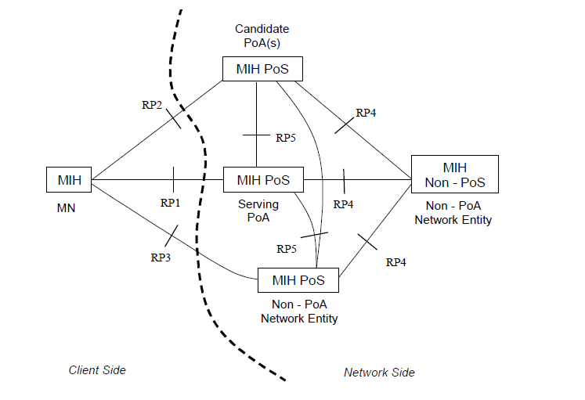
IEEE-2008 Communication Model

Slide 9
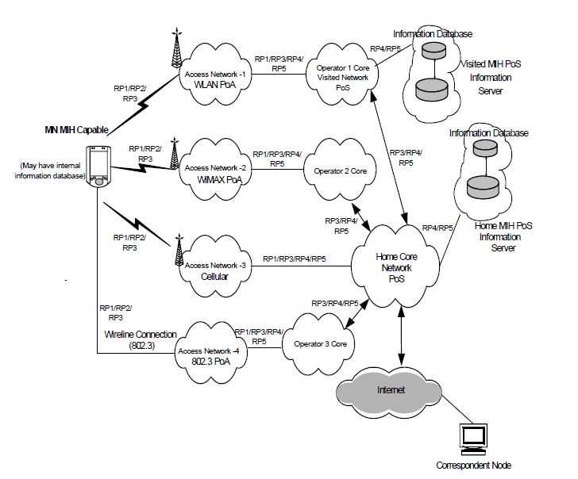
Example Network Model using MIH Services

Slide 10
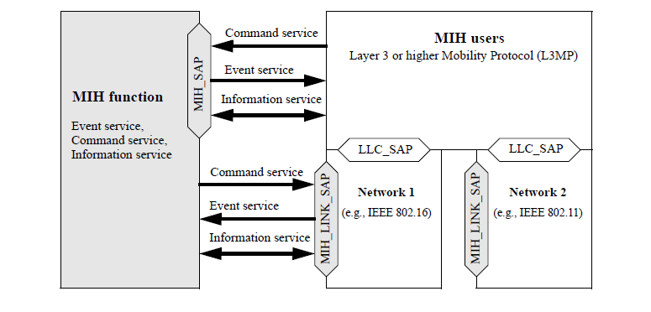
MIH Services and Initiation

Slide 11
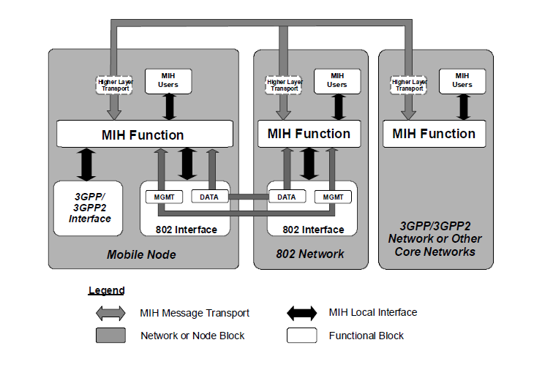
MIHF Relationship Model

Slide 12
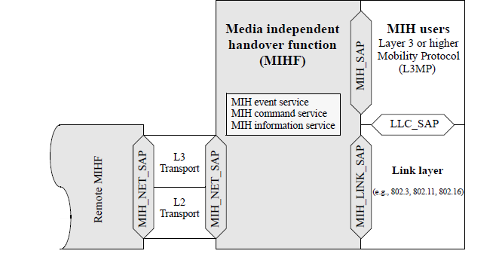
MIH Reference Model and SAPs

Slide 13
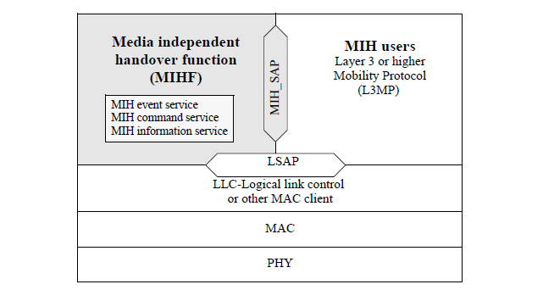
MIH Reference Model for 802.3

Slide 14
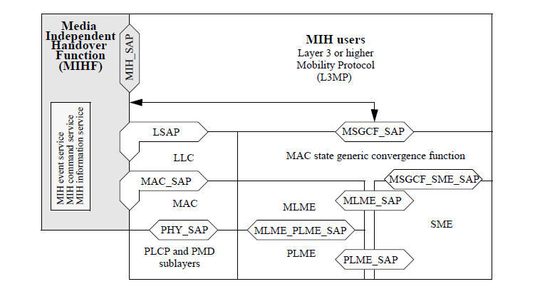
MIH Reference Model for 802.11

Slide 15
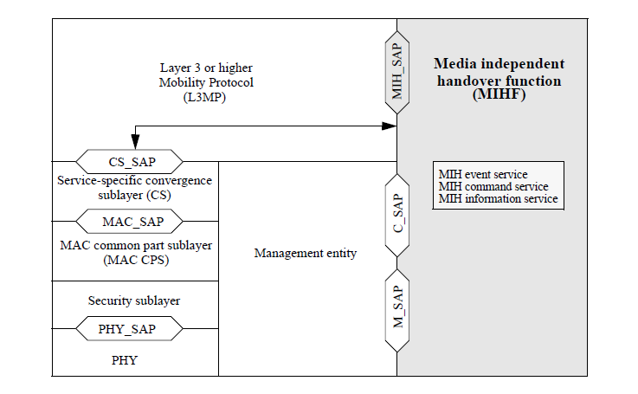
MIH Reference Model for 802.16

Slide 16
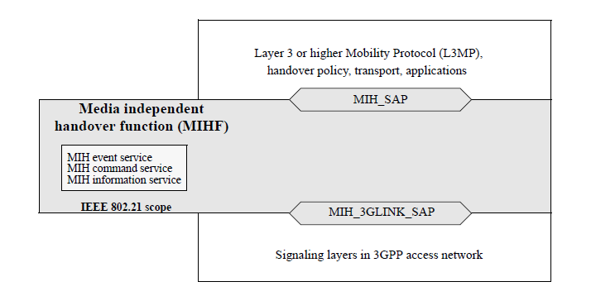
MIH Reference Model for 3GPP

Slide 17
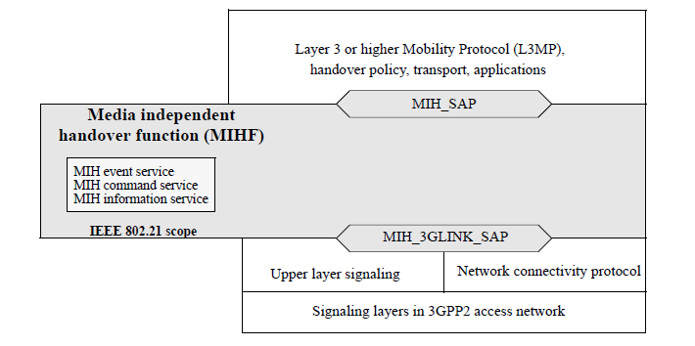
MIH Reference Model for 3GPP2

Slide 18
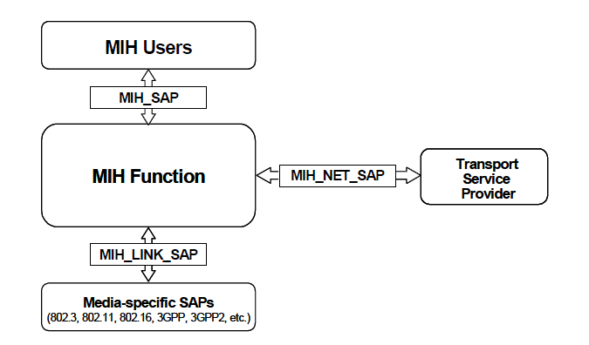
Relationship Between MIH SAPs

Slide 19
MIH Protocol
MIH Protocol Features
  A transaction based Request-Response-Indication message protocol
  Support Fragmentation and Re-assembly
  Support reliability via Acknowledgement
  Transport over both L2 and L3
  Security mechanism is under development via amendment project

Slide 20
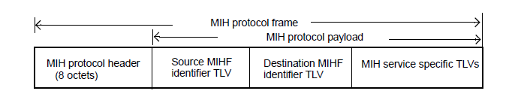
MIH Protocol Frame Format

Slide 21
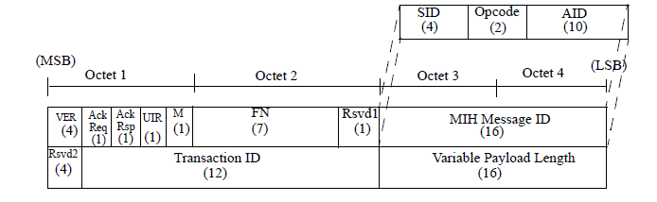
MIH Protocol Header Format

Slide 22
IEEE 802.21 Current Projects
Three amendment Projects
  802.21a (TGa): Amendment for Security Extensions to Media Independent Handover Services and Protocol
  802.21b (TGb): Amendment for Handovers with Downlink Only Technologies
  802.21c (TGc): Amendment for Optimized Single Radio Handovers

Slide 23
TGa Officers
Office | Officer
Chair | Yoshihiro Ohba, Toshiba
Editor | Lily Chen, NIST

Slide 24
IEEE 802.21a
Scope
  Defining mechanisms to reduce the latency during authentication and key establishment for handovers between heterogeneous access networks that support IEEE 802.21
  Providing data integrity, replay protection, confidentiality and data origin authentication to IEEE 802.21 MIH (Media-Independent Handover) protocol exchanges and enable authorization for MIH services

Slide 25
IEEE 802.21a contd..
Progress so far
  Jan 2009: The 1st meeting
  Mar 2009: Issued CFP
  July 2010: Down-selection
  Nov 23 – Dec 23 2010: WG Letter Ballot (LB5)
  Feb 15 – Mar 1 2011: WG Letter Ballot 1st recirculation (LB5a)

Slide 26
TGb Officers
Office | Officer
Chair | Juan Carlos Zuniga, InterDigitial
Vice Chair | Burak Simsek, Fraunhofer FOKUS
Editor | Hongseok Jeon, ETRI

Slide 27
IEEE 802.21b
The TG work on an amendment to the 802.21-2008 specification that defines extensions to support unidirectional links
This amendment will allow supporting handovers with downlink-only/broadcast radio access technologies

Slide 28
IEEE 802.21b
Scope
  Defines mechanisms that enable the optimization of handovers between IEEE 802.21 supported technologies and downlink-only (DO)/broadcast technologies
Progress so far
  TG completed 1st WG LB on September 08, 2010
  1st re-circulation LB completed on December 22, 2010
  2nd re-circulation will happen after March, 2011 meeting

Slide 29
TGc Officers
Office | Officer
Chair | Junghoon Jee, ETRI
Vice Chair | Anthony Chan, Huawei
Editor | Dapeng Liu, China Mobile

Slide 30
IEEE 802.21c
Scope:
  Define enhancements to enable optimized single radio handovers between heterogeneous IEEE 802 wireless technologies, and
  extend to single radio handovers between IEEE 802 wireless technologies and cellular technologies
  based on media access independent mechanisms.

Slide 31
IEEE 802.21c contd..
Progress So far
  TG Structure and procedure -- January, 2010 (Selection Procedures, Functional Requirements, framework)
  Call for proposals in January 2010
  Proposal presentations and discussions (March, May, Sept, Nov 2010, Jan 2011)
  TG is working on the draft specification
Notes:
31

Slide 32
IEEE 802.21
Information
http://www.ieee802.org/21
http://mentor.ieee.org/802.21/documents

Slide 33
Future Meeting – 2011
Interim: 16-19 May 2011, Alberta, Canada.
  Meeting co-located with 802.16
Plenary: 18-21 July 2011, San Francisco, USA
  Co-located with all 802 groups
Interim: 19-22 September 2011, TBD
  Meeting co-located with 802.16
Plenary: 7-10 Nov 2011, Atlanta
  Co-located with all 802 groups

