Slide 1

General Session Meeting
Transformers Committee
St. Louis, Missouri
October 21, 2013
Notes:
Good Morning Everyone!
A very big welcome to all of you to our Main Committee Meeting to help kick off the week of activities here in St. Louis for our Fall 2013 meeting.
Some of you may have heard that we are very excited about this being our biggest meeting yet, with over 540 attendees plus over 60 spouses/companions. This is good testament to the culture and the reputations that we, the Transformers Committee have built over the years for not only having a top rate technical program, but also balanced with some great social mixers and technical tours through out our meeting week to make this a rich learning environment and a rewarding experience both professionally and personally.
Once again, this rewarding experience is made possible because of our host Ed smith and his dedicated host team from H-J Family of Companies have been hard at work over the past several months, and working in close collaboration with our meeting planning team to create this great program for us this week, starting with the wonderful receptions we had last night. Having been a host myself back in 2004, I know what it takes to pull off a great program and I just want to say thank you again Ed Smith, and also to our meeting planner, Greg Anderson for all of your hard work. I have no doubt that this is going to be another great week!

Slide 2
Chair’s Opening Remarks
General Session Meeting
Transformers Committee
St. Louis, Missouri
October 21, 2013
Notes:
Since you’re my captured audience, I am going to exercise my Chair’s prerogative to share few thoughts with you.
Some of you have heard about my story of how I started with a humble beginning after graduating from engineering school. And how my career have benefited tremendously because of my association with IEEE, and specifically because of my involvement with the Transformers Committee. I can honestly say that I would not have reach the level of my career success without IEEE.
Over the past several years, I have reflected and pondered on “What is it that makes IEEE Transformers Committee great?”
And particularly, why is it that many of us in room, have been so tirelessly devoted to this organization, when considering that all of this work is volunteer based. I came to the conclusion that it is the culture of this organization that made us great. And if you think about it some more – about what makes our culture – this elusive word culture – it really isn’t one particular thing, but it really is a collection of our core behaviors that we hold near and dear our hearts, and it is also the core mission of IEEE.

Slide 3
Fostering technological innovation and excellence for the benefit of humanity.
Notes:
Fostering technological innovation and excellence for the benefit of humanity.
There are only 10 words in this tag line. But these are 10 powerful words – that definitely has resonated with me and I hope for you as well.
I also believe that all of us, in the course of being involved in our standards work, while we may be driven by different interests, we, as scientists and engineers, fundamentally strive to make things better, much like the words of the IEEE mission – to Foster technological innovation and excellence for the benefit of humanity, and that we all of have the highest respect for this organization and for the people that make this organization great.
Beyond these 10 powerful words, there is a set of guiding principles that I thought worth while sharing as a refresher. Because we all come from different backgrounds, various different level of expertise and knowledge, and have different interests. In the course of making these improvements, our actions and behaviors some times could be misinterpreted, and occasionally in our passion to drive towards our goals and objective we could unknowingly veer off the main road once in a blue moon and be perceived differently from our best intentions.
I think this is where our IEEE Code of Ethics comes in – it serves as the guiding light to keep us focused on maintaining and evolving our culture that make this organization great. So, let me read through these quickly.

Slide 4
IEEE Code of Ethics
We, the members of the IEEE, in recognition of the importance of our technologies in affecting the quality of life throughout the world, and in accepting a personal obligation to our profession, its members and the communities we serve, do hereby commit ourselves to the highest ethical and professional conduct and agree:
Notes:
IEEE Policies, Section 7 - Professional Activities

Slide 5
IEEE Code of Ethics (cont.)
to accept responsibility in making decisions consistent with the safety, health, and welfare of the public, and to disclose promptly factors that might endanger the public or the environment;
to avoid real or perceived conflicts of interest whenever possible, and to disclose them to affected parties when they do exist;

Slide 6
IEEE Code of Ethics (cont.)
to be honest and realistic in stating claims or estimates based on available data;
to reject bribery in all its forms;
to improve the understanding of technology; its appropriate application, and potential consequences;

Slide 7
IEEE Code of Ethics (cont.)
to maintain and improve our technical competence and to undertake technological tasks for others only if qualified by training or experience, or after full disclosure of pertinent limitations;
to seek, accept, and offer honest criticism of technical work, to acknowledge and correct errors, and to credit properly the contributions of others;

Slide 8
IEEE Code of Ethics (cont.)
to treat fairly all persons regardless of such factors as race, religion, gender, disability, age, or national origin;
to avoid injuring others, their property, reputation, or employment by false or malicious action;

Slide 9
IEEE Code of Ethics (cont.)
to assist colleagues and co-workers in their professional development and to support them in following this code of ethics.
Notes:
So, what else make this organization great? In addition to the code of ethics, there are the friendships we have with each other, our high standards of technical focus in our discussions that are free from overt commercialism, our team of dedicated volunteers that inspires and challenges me to do even more.
I think all of these things together, creates an excellent learning environment that stays true to our core mission of Fostering technological innovation and excellence for the benefit of humanity.
To me, these are our collective culture that what makes us great. In my humble opinion, it is what sets us apart from other technical committees. For this reason, I’m inspired to continue to be involved and contribute where I can even though I will be passing on my leadership baton to our Vice Chair, Don Platts, starting next year as part of our officer’s progression cycle.
In closing, I’ll will say ask yourself, not what that IEEE Transformers Committee can do for you, but ask where would you be in your career if it wasn’t for IEEE Transformers Committee and ask what can you do for the Committee to be even greater than what it already is. For the great many of you, who already devoted countless hours towards our core mission, let us put our hands together for a nice round of applause in appreciation of your efforts. For those of you that are just starting or have been sitting on the side line, this is your call to action - - to get in the game and be a part of the great organization and contribute. So, I thank you for your attention and for letting me share few of the thoughts I have.
This is actually a good segue for me to make the announcement about our officers’ progression starting January 1, 2014.

Slide 10
Officers Progression
2014-2015
Chair: Donald W. Platts
Vice Chair: Stephen Antosz
Secretary:
Standards Coordinator: William (Bill) H. Bartley
Treasurer: Greg W. Anderson
Awards Chair/Past Chair: Bill Chiu
Susan McNelly

Slide 11
Adcom Report
General Session Meeting
Transformers Committee
St. Louis, Missouri
October 21, 2013

Slide 12
IEEE-SA’s Role
IEEE-SA’s role
  Standards development organization that
    Develops voluntary standards, recommended practices, and guides
    Uses an accredited process that promotes consensus building among those with material interest in any given technology, and is based on proven imperative principles of openness, consensus, balance, due process, and right of appeal
    Oversees the process by which consensus is reached
    Has standards that are adopted by regulatory agencies and international bodies around the world
    Promotes standards implementation but does not define laws or regulatory requirements
    Defines technical requirements, not market mechanisms
    Reviews documents based on technical merit, and established scientific findings

Slide 13
IEEE-SA does not…
IEEE-SA does not
  Test or verify the content of standards
  Assure health or safety
  Make guarantees
  Make warrantees
  Establish law or regulation
  Define essential patents, essential patent holders, or licensing terms
  Define commercial terms or market mechanisms
  Infer that an IEEE standard endorses products, services, or companies

Slide 14
Press Releases
  Press releases about IEEE standards by outside entities without approval by IEEE
  Cannot claim that the IEEE standard endorses a product, service, or company
  Cannot claim that the standard establishes requirements based on information in informative text (including informative annexes)
  Cannot include marketing text about IEEE or IEEE-SA that may infer endorsement by IEEE or IEEE-SA
  Must clearly indicate that all statements are that of the entity and does not necessarily represent a position or opinion of either IEEE or the IEEE Standards Association

Slide 15
IEEE-SA Disclaimers
Official Statements
A statement, written or oral, that is not processed in accordance with the IEEE-SA Standards Board Operations Manual shall not be considered the official position of IEEE or any of its committees and shall not be considered to be, nor be relied upon as, a formal position of IEEE. At lectures, symposia, seminars, or educational courses, an individual presenting information on IEEE standards shall make it clear that his or her views should be considered the personal views of that individual rather than the formal position of IEEE.

Slide 16
Announcement of Affiliation
Core objectives of the standard development process - Openness and Due Process
  Allows for equity and fair play
  Strive to have a balance of interests and not to be dominated by any single interest category
Affiliation Disclosure
  Not just who you are, but also who is your financial sponsor

Slide 17
TECHNICAL COUNCIL OFFICERS
Chair - Jeffrey H. Nelson (TVA)
Vice Chair - S. S. (Mani) Venkata (Alstom) Resigned October 1, 2013
Secretary - Ken Edwards, (BPA)
Past Chair - Damir Novosel, (QuantaTechnology)

Slide 18
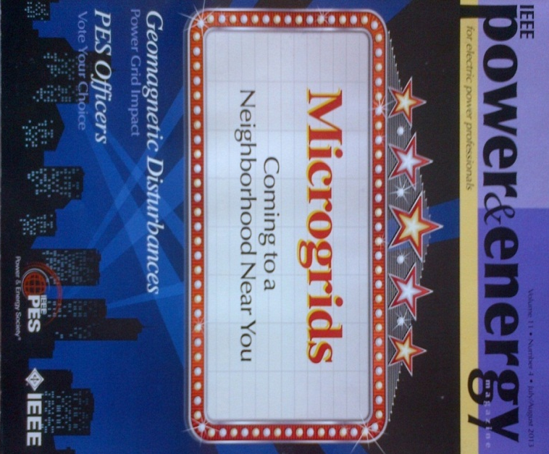
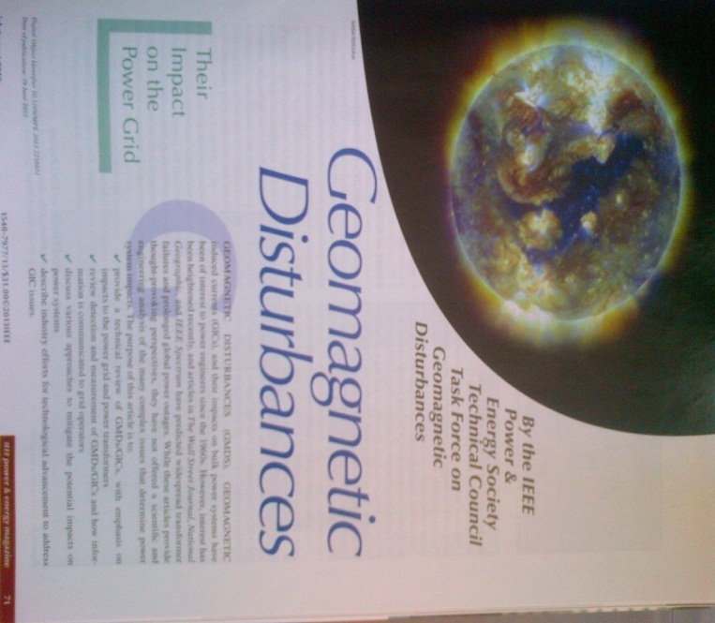
GMD Task Force Update
Published P&E Magazine article
  Geomagnetic Disturbances – Their Impacts on The Power grid

Slide 19
GMD Supersession
GMD Supersession at PES General Meeting in Vancouver on July 23, 2013
  Entire session is recorded and available on youtube - http://www.youtube.com/watch?v=gE-H8VSzNXY
Currently working on finalizing the comment resolution of the Task Force Technical Paper

Slide 20
GMD Super Session Presentation Sequence
Bill Chiu – Southern California Edison
Overview of GMD & PES Tech Council Task Force on GMD
David Hilt – Quanta Technology
Regulatory Update
David Boteler – Natural Resources Canada
Modeling Geomagnetically Induced Currents – The Evolution in Techniques over the last 30 years
Ramsis Girgis – ABB St. Louis
Methodology for Evaluating the Impact of GIC and GIC Capability of Power Transformer Designs

Slide 21
GMD Super Session Presentation Sequence
Jeff Dagle – Pacific Northwest Labs
Geomagnetic Storms and Long-Term Impacts on Power Systems
Emanuel E. Bernabeu – Dominion Power
Impacts of GICs on the Dominion Power System
John Kappenman – Storm Analysis Consultants
Low-Frequency Protection Concepts for the Electric Power Grid: Geomagnetically Induced Current (GIC) and E3 HEMP Mitigation – FERC Meta 322 Update
Q&A & General Discussions

Slide 22
Endorsement
IEEE Standards Association does not infer that an IEEE standard endorses products, services, or companies

Slide 23
IEEE Fellows – Individual Contributor
Application Engineer/Practitioner
  Responsible for product development, advancement in system, application or operation, project management or construction activity, process development, manufacturing innovation, codes or standards development, or other application of technology
Educator
  Responsible to advance electrical engineering and scientific technology through education by the developing curricula and/or courses that are innovative and unique
Research Engineer/Scientist
  Responsible for inventions, discoveries or advances in the state of the art technological advances
Technical Leader
  Responsible for a managerial, team, or company-wide effort using technical innovation, and resulting in outstanding performance, economic enhancements, or other advantages to benefit society

Slide 24
Fellow Nomination Process
Nominator
Any person, including non-members, are eligible to serve as a nominator with the following exceptions:
  Members of the IEEE Board of Directors
  Members of the IEEE Fellow Committee
  IEEE Technical Society/Council Fellow Evaluating Committee Chairs
  Members of IEEE Technical Society/Council Fellow Evaluating Committee reviewing the nomination, or IEEE Staff.
Nominee
Must be an IEEE Senior Member in good standing and he/she must have completed five years of service in any grade of membership. The nominee cannot be a member of:
  The IEEE Board of Directors
  The IEEE Fellow Committee
  IEEE Technical Society/Council
  Fellow Evaluating Committee Chair
  A member of IEEE Society/Council Fellow Evaluating Committees reviewing the nomination

Slide 25
Data Non-Disclosure Agreement
Proposal
  Setup an input site to allow submission of data to IEEE. Suggest we provide a spreadsheet for the input. Therefore, we could automate the compilation and ensure that the anonymity of the submitter is maintained
  User will need to click through and agree to the NDA in order to access the compiled data

