Slide 1

Transformers Committee
Standards Luncheon
Standards Development
Monday March 25, 2019
Speakers:
Jim Graham
Malia Zaman

Slide 2
Standards Luncheon topics
  C57.12.00 & C57.12.90 Revision Process – Jim Graham
  WG Basics: PAR Process – Michelle Turner
  Q&A - all

Slide 3
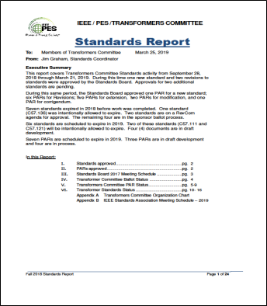
Fall 2019 Report is available now on our website
Thanks Susan!

Slide 4
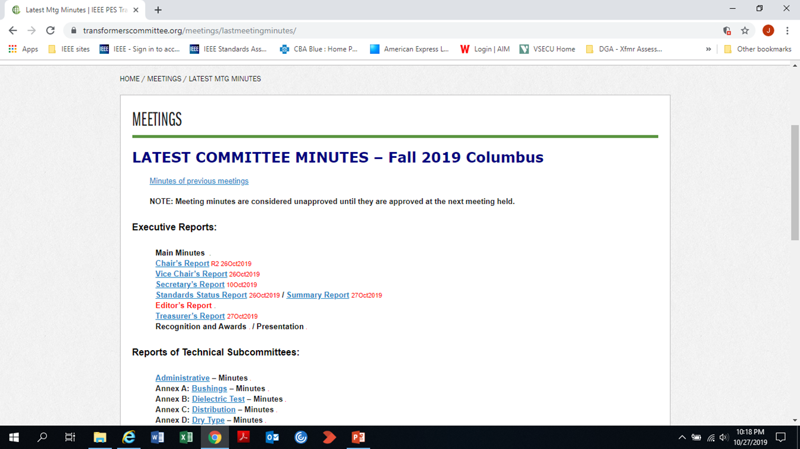
Where is the Standards Report ?
Here it is !!!!
(on Transformers Latest Minutes page)

Slide 5
Submission Deadline for the last Standards Board meeting in 2020 is Tuesday,
October 13th
²⁰²⁰

Slide 6
Description of the Process We Follow for Continuous Revision of
IEEE Std C57.12.00 General Requirements and
IEEE Std C57.12.90 Test Code
IEEE/PES Transformers Committee
October 2019
Stephen Antosz

Slide 7
Overview
C57.12.00 & C57.12.90 provide the foundation for many of the documents in the C57 Series.
They are updated every few years to capture the current state of transformer technology and manufacturing processes.
Change topics are continuously being worked on in the various Task Forces, which are part of various Subcommittees. Once they are complete, they are passed to the WG in the Standards Subcommittee for inclusion in the next ballot cycle.

Slide 8
C57.12.00 Subcommittee Responsibility Matrix

Slide 9
C57.12.90 Subcommittee Responsibility Matrix

Slide 10
Task Forces for C57.12.00 & 12.90
  Performance Characteristics Subcommittee
PCS Revisions to 12.00
Chair, Tauhid Ansari
PCS Revisions to 12.90
Chair, Hakan Sahin
Audible Sound Revisions to 12.00 & 12.90;
Chair, Ramsis Girgis
Short-circuit revisions; Inactive,

Slide 11
Task Forces for C57.12.00 & 12.90
  Dielectric Test Subcommittee
Revisions to Low Frequency Tests
Chair, Bill Griesacker
Revisions to Impulse Tests for 12.00 & 12.90
Chair, Pierre Riffon
  Insulation Life Subcommittee
Revisions to Temperature Tests; Inactive.

Slide 12
Working Groups for C57.12.00 & 12.90
  Standards Subcommittee
WG for Continuous Revisions to 12.00; Chair, Steve Snyder
WG for Continuous Revisions to 12.90; Chair, Stephen Antosz
PAR responsibility resides with these Working Groups, not the Task Forces.
When the document is ready for sponsor ballot, the WG Chair moves it forward via IEEE-SA’s MyProject system.
WG membership consists of the Task Force Chairs and the Subcommittee Chairs. And this same group becomes the ballot resolution committee after balloting and recirculations.

Slide 13
Past process
Due to the many technical subjects covered by these standards, suggestions and questions to be considered in each revision have been delegated to the Subcommittee whose scope is most clearly aligned with the issue.
The subcommittee then works through the issues that have been delegated to them, and frequently forms task forces focused on specific items.
The Subcommittee and/or task forces work to reach consensus and then propose new or revised clauses to be added to C57.12.00 or C57.12.90

Slide 14
Past process
In most subcommittees, progress is reported in Subcommittee meetings and minutes of the task forces are provided.
The TF comes to consensus of its members via surveys. Once the TF completes it work, it passes it up to its respective SC Chair. The SC membership then votes to approve the topic (simple majority needed) to be forwarded to the WG in the Standards Subcommittee for inclusion in the next revision ballot of the document.

Slide 15
Process revisions and updates
Working group process needs to be enhanced to be open to all who wish to participate
Working group meetings and minutes are required. Should we have a WG meeting?
All decisions require consensus of the working group, with motions and votes as required

Slide 16
Process revisions and updates
The working group shall reach consensus that the revised document is ready to move to ballot, followed by process vote of the Standards Subcommittee
None of these things preclude the working group from establishing a schedule and cutoff date for changes and additions to the standards so that they can periodically move forward for ballot.

Slide 17

Any Questions?
Notes:
17

