Slide 1
IEEE PES Transformers Committee
Administrative Subcommittee Meeting
- Chair’s Report -
November 9, 2021

Slide 2
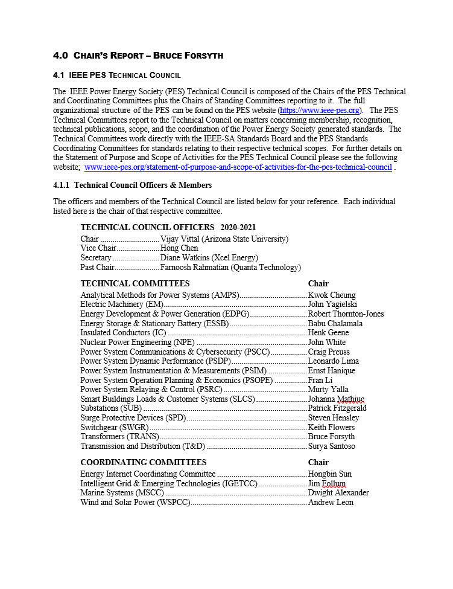
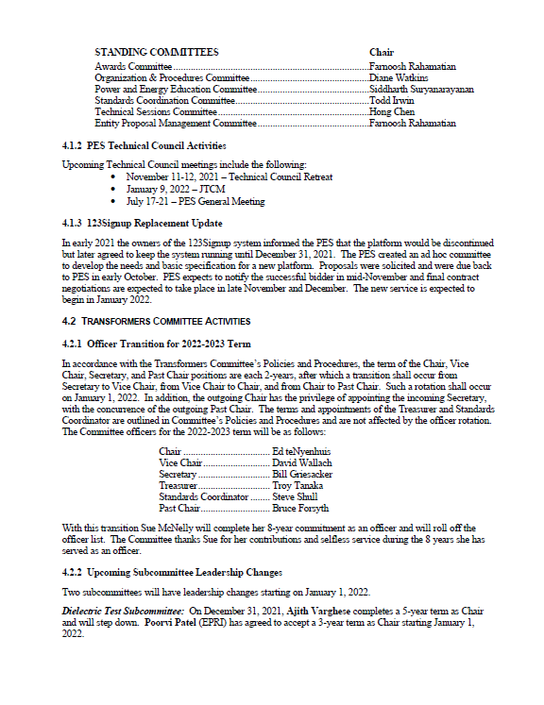
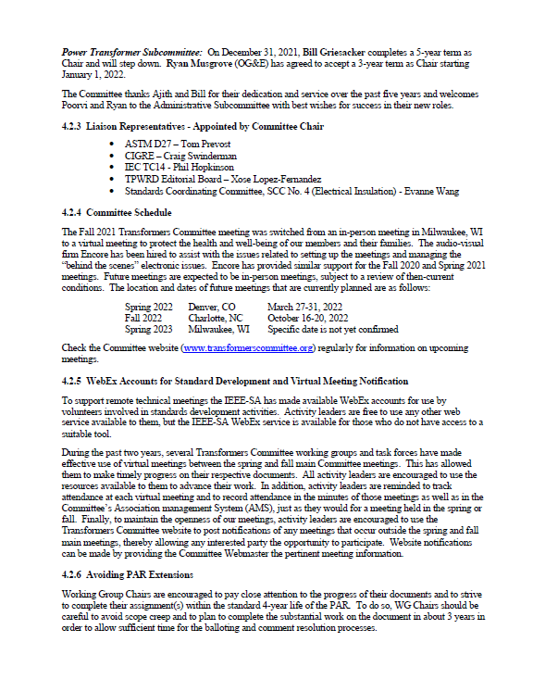
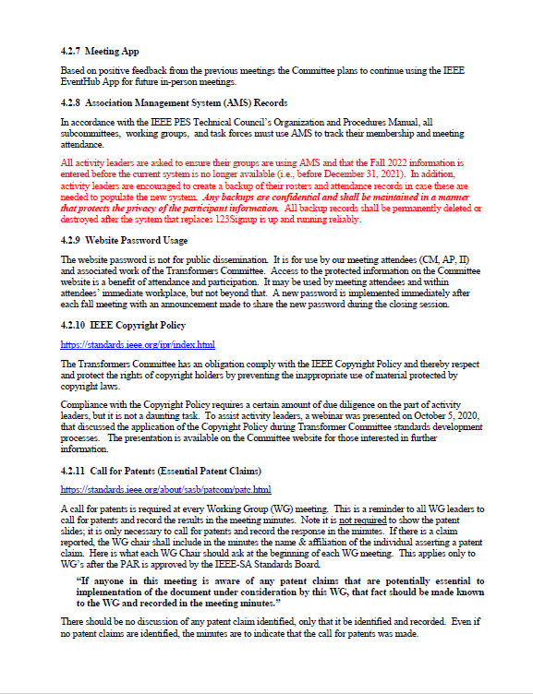
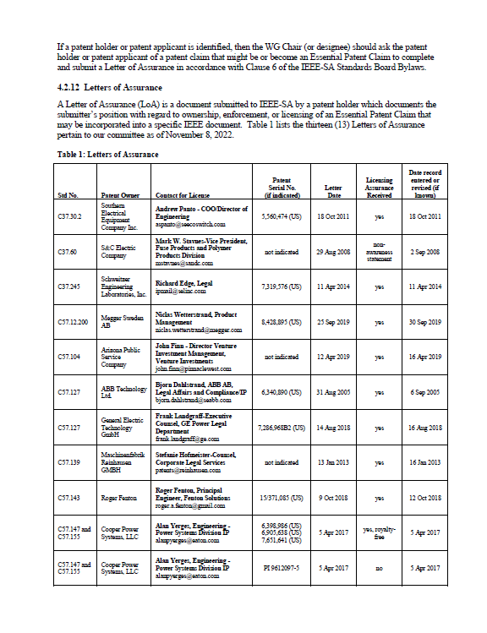
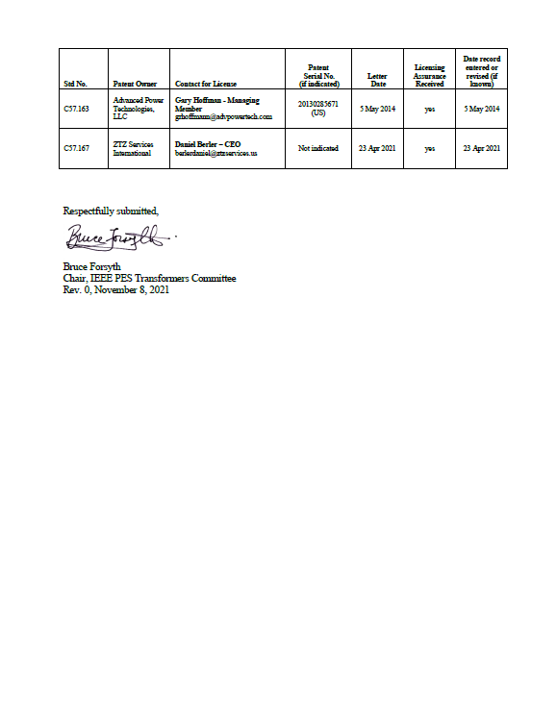
Chair’s Report to AdCom
The full Chair’s Report will be posted in the Committee website.
This summary report touches of a few key issues of specific interest to AdCom.

Slide 3
Chair’s Report to AdCom
123Signup Replacement Update
In early 2021 the owners of the 123Signup system informed the PES that the platform would be discontinued but later agreed to keep the system running until December 31, 2021.
The PES created an ad hoc committee to develop the needs and basic specification for a new platform.
Proposals were solicited and were due back to PES in early October.
PES expects to notify the successful bidder in mid-November and final contract negotiations are expected to take place in late November and December.
The new service is expected to begin in January 2022.

Slide 4
Chair’s Report to AdCom
Officer Transition on January 1, 2022
Officer Roster for 2022-2023:
Chair Ed teNyenhuis
Vice Chair David Wallach
Secretary Bill Griesacker
Treasurer Troy Tanaka
Standards Coordinator Steve Shull
Past Chair Bruce Forsyth
Sue McNelly completes her 8-year commitment and will roll off the officer list.
The Committee thanks Sue for her contributions and selfless service during the 8 years she has served as an officer!

Slide 5
Chair’s Report to AdCom
Subcommittee Leadership Changes on January 1, 2022
Dielectric Test Subcommittee
  Ajith Varghese completes a 5-year term as Chair
  Poorvi Patel starts a 3-year term as Chair
Power Transformers Subcommittee
  Bill Griesacker completes a 5-year term as Chair
  Ryan Musgrove begins a 3-year term as Chair
The Committee thanks Ajith and Bill for their service and welcomes Poorvi and Ryan to their new roles and to the Administrative Subcommittee.

Slide 6
Chair’s Report to AdCom
Liaison Representatives
ASTM D27 – Tom Prevost
CIGRE – Craig Swinderman
IEC TC14 - Phil Hopkinson
TPWRD Editorial Board – Xose Lopez-Fernandez
SCC04 (Electrical Insulation) - Evanne Wang

Slide 7

Chair’s Report to AdCom
WebEx Accounts for Standards Development
IEEE-SA makes WebEx accounts available for standards development activity leaders.
Several activity Chairs have made good use of these services (or similar services) to hold meetings between the spring and fall Committee meetings to help move the documents forward.
GREAT WORK!!

Slide 8
Chair’s Report to AdCom
Avoiding PAR Extensions
Working Group Chairs – please strive to complete your assignment(s) within the standard 4-year life of the PAR.
Avoid scope creep.
Delegate and monitor.
Plan on completing the substantial work on the document in about 3 years in order to allow sufficient time for the balloting and comment resolution processes.

Slide 9

Chair’s Report to AdCom
AMS Data Entry by December 31!!
All activity leaders are asked to ensure their groups are using AMS and that the Fall 2021 information is entered before the current system is no longer available (i.e., before December 31, 2021).
In addition, activity leaders are encouraged to create a backup of their rosters and attendance records in case these are needed to populate the new system.
Any backups should be considered confidential and shall be maintained in a manner that protects the privacy of the participant information.
All backup records shall be permanently deleted or destroyed after the system that replaces 123Signup is up and running reliably.

Slide 10
Chair’s Report to AdCom
WG Leadership Diversity
In order to ensure our documents serve the best interests of the public and to avoid any perception of dominance or unfair influence, the leadership of our WGs should be diverse.
SC Chairs should strive to ensure WG officers (Chair, Vice Chair, Secretary)
  Don’t represent the same company/affiliation
  Represent both users and manufacturers

Slide 11
The End
Thank You for Your Attention!

