Slide 1
Standards Report

Slide 2
IEEE-SA Updates – PAR/Standards Status
8 PARs are expiring in 2021:
      1 PAR in SA Ballot stage;
      5 PARs are on the NesCom Dec 7th Agenda for PAR extensions;
      3 PARs are recommended for SASB Approval; and
      4 Standard review-for-revision TFs are working.
Standards moving to Inactive-Reserve status in 2021:
  8 Standards will become inactive with no PAR in place; and
  2 do not have a PAR for revision.

Slide 3
IEEE-SA Updates – PAR/Standards Status
17 PARs are expiring in 2022:
      3 PARs are in Comment Resolution/SA Ballot stage;
      13 PARs are in Working Group Development; and
      1 PAR is on the NesCom Dec 7th Agenda for an Extension.
Standards moving to Inactive-Reserve status in 2022:
  8 Standards will become Inactive – Reserved; and
  1 Standard is without any active PAR.

Slide 4
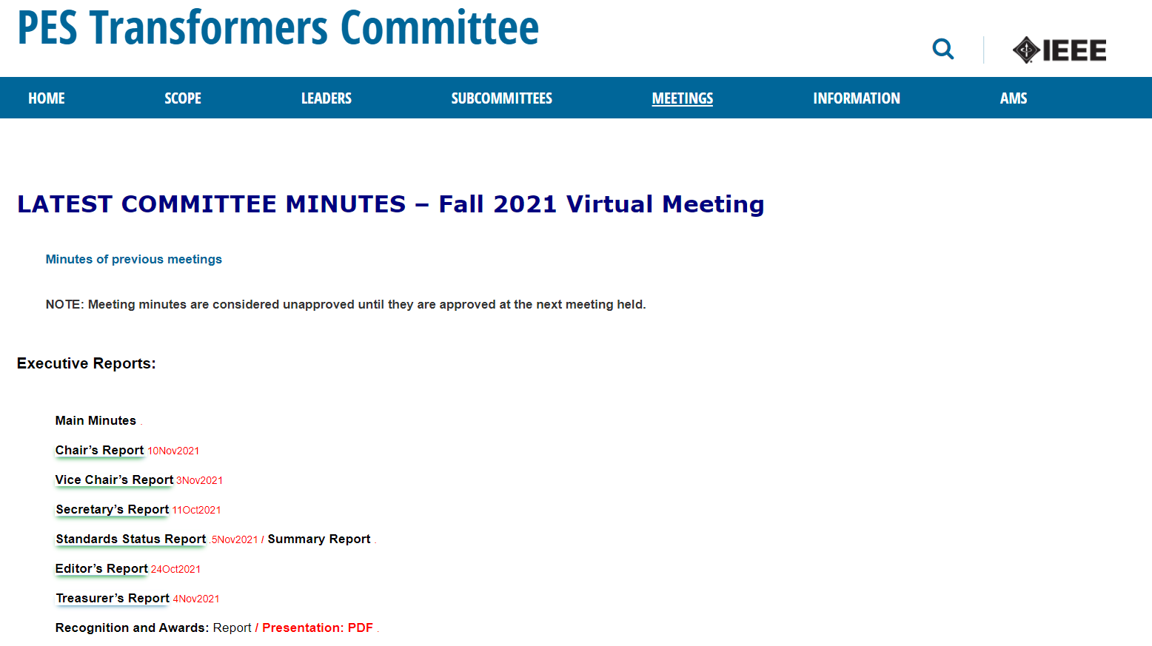

Standards’ Report Location
Notes:
The standard report has been posted on the webpage. This report contains all of the information on the Working Groups and Task Forces that I have access to. The information located on the first 8 pages covers all of the information that I can glean from the subcommittees’ web pages. I would encourage all working group chairs and SC chairs to update this information.
The remainder of the report is the information which was obtained from the IEEE myProject application as well as comments submitted or made by various sources. Keep in mind this portion of the report will only list established standards or guides, or projects that have active PARs. No taskforces will be mention in this part of the document.

Slide 5
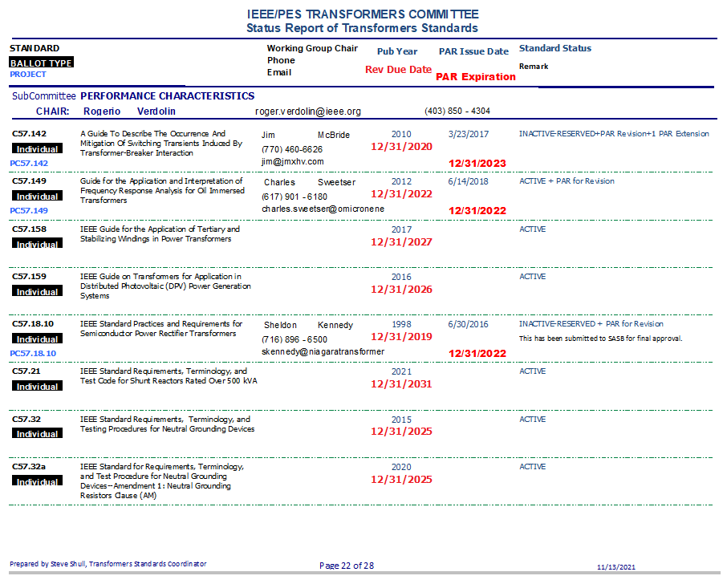
Notes:
This gives you an idea of the format of the report. I want to point out a couple of things about this report.

Slide 6
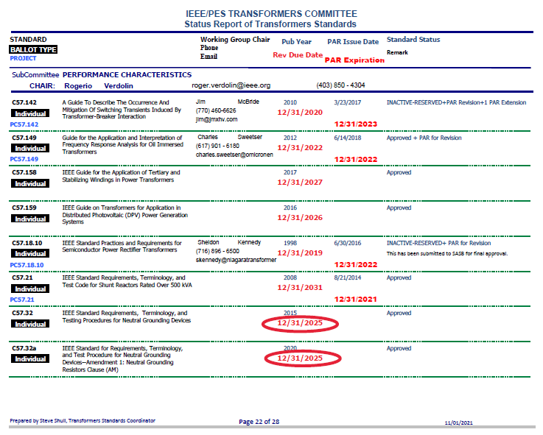
Notes:
To do this I have added some ovals.
The items circled in black explain the status of the Standard or PAR. These are in process of revision.
The items circled in red shows the date the Standard will be moved to Inactive- Reserved. For the document to be revised in a normal PAR life, the revision has to start four years prior to this date. As you can see the work on these should have already started but no PAR is registered at this moment.
It is important to note that a PAR is for 4 years. This means that the work should be moving to ballot by the end of the third year so it can be approved by the expiration of the PAR. Another problem we seem to be having is to get these to ballot in a timely manner.
As a matter of note, if the PAR is pushing toward a second PAR extension, the scrutiny of the NesCom is heightened. We currently have a couple of PARs that are in their second extension. I would suggest that these WG Chairs be encouraged to finish quickly. This is not a good situation as it can complicate the standards status. I just wanted to warn all WG members of these issues.

Slide 7
What does it means when a Standard/Guide goes to INACTIVE – RESERVED?
Notes:
Standards which are in the Inactive – Reserved category still exist and are available for purchase. So why should we be concerned?

Slide 8
What does it means when a Standard/Guide goes to INACTIVE – RESERVED?
These standards are removed from active status through an administrative process for standards that have not undergone a revision process within 10 years.
This could leave a question in the user’s mind if the standard is valid, since it hasn’t been looked at for 10 years.
Notes:
The first bullet point shows the IEEE definition of what this means.
So why should we be concerned? (Read Statement)
This would cause me to be hesitant to use them.

Slide 9
Entity PAR Report
Project Number | Subcommittee | Project Title | Approval PAR Date | Expiration PAR Date | Project Status | Standards Committee Representative SCR
PC57.12.200 | Dielectric Test | Guide for the Frequency Domain Spectroscopy Measurement of Transformer Bushings | 27 Sep 2018 | 31 Dec 2022 | Draft Development | Poovi Patel
PC57.12.210 | Distribution Transformer | Recommended Practice for On-load Capacity Switching Distribution Transformers | 10 Feb 2021 | 31 Dec 2025 | Draft Development | Jerry Murphy
PC57.141 | Performance Characteristics | Guide for Detection, Monitoring, and Evaluation of Winding Deformation in Liquid-Immersed Power Transformers | 23 Sep 2021 | 31 Dec 2025 | Draft Development | Poovi Patel
PC57.32.10 | Performance Characteristics | Guide for the Selection of Neutral-Grounding Devices for High Voltage Direct Current (HVDC) Converter Transformers | 30 Oct 2018 | 31 Dec 2022 | Draft Development | ______
PC57.93a | Power Transformer | IEEE Approved Draft Guide for Installation and Maintenance of Liquid-Immersed Power Transformers Amendment: Cold Start of Power Transformers filled with Natural Ester Fluids | 05 Mar 2020 | 31 Dec 2024 | Draft Development | Scott Reed
 | Unassigned (Inquiring of Instrument Transformer Subcommittee) | Guide for Live Line Calibration Calibrator of Current Transformers in Distribution Network used in voltage systems, 34.5 kV and below. |  |  | Submitted for Sponsor
Notes:
This shows the Entity PARs we have under our committee’s scrutiny. These PARs are participated in via company, organization or institution membership. Therefore as individuals we cannot participate in their development. However, the standards committee has a representative to provide input and counsel on the Working Group. This person doesn’t have voting rights but can greatly influence the direction of the document. If you have any comments or concerns on the project, please feel free to reach out to these individuals or the Subcommittee Chairs. This information is included in the Standards report.

