Slide 1
XML Update
and
Introduction to the MS Word template
for IEEE standards drafts
Lisa Perry
IEEE-SA Content Production and Management

Slide 2
Topics
XML Update
Introduction to the MS Word template for IEEE standards drafts
  What is the template?
  Why use the template?
  How do I access…
    the template?
    IEEE-SA training videos?
Key features of the Template
Initial Steps for Working in the Template: New vs. Revision
Tips and tricks

Slide 3
XML Update

Slide 4

Where are we now?
SA Next-Gen Publishing project
  Implementation 2016
  In-house generated XML delivered to Xplore
XML-derived products
  HTML
  Mobile apps
Possible future mobile apps
  1584 Arc Flash
  standard
  DASC standards
Ideas for new products?

Slide 5
Introduction to the MS Word template for IEEE standards drafts

Slide 6
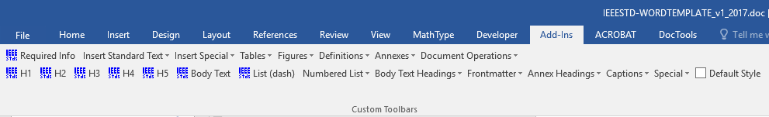
What is the Word Template?
Word document with custom toolbars that run macros
A macro is a series of commands and instructions grouped together as a single command to accomplish a task automatically.

Slide 7
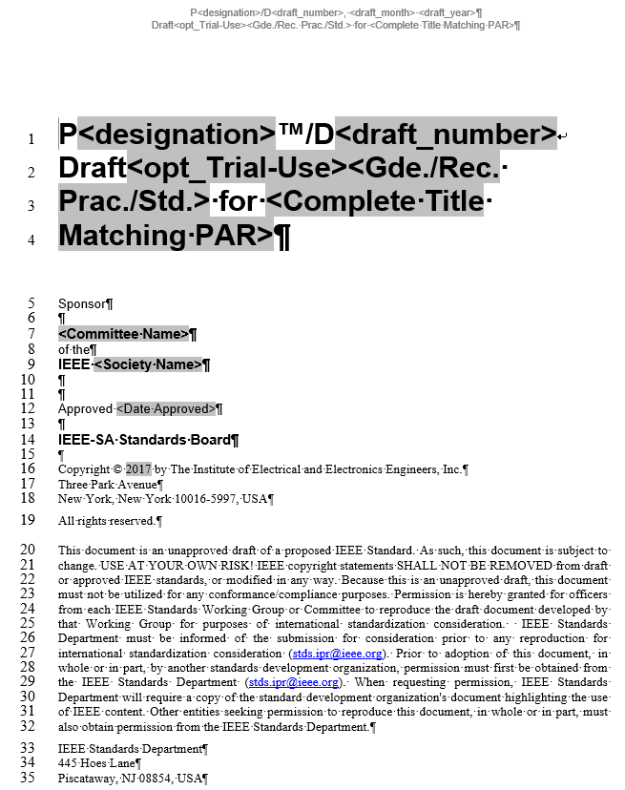
Why Use the Word Template?
Using macros saves time
Includes basic structure and formatting
Updated along with updates to
IEEE Standards Style Manual
Easier to maintain the standard with roundtrip document

Slide 8
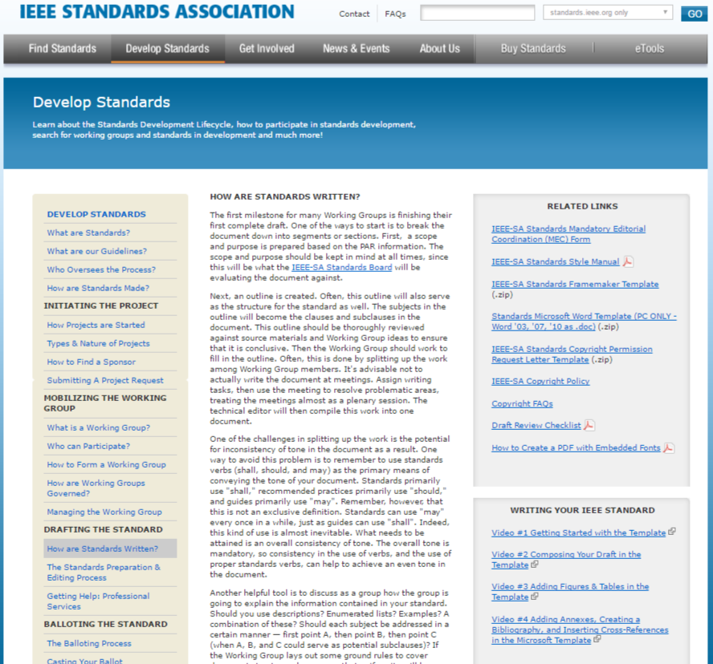
How Do I Access… the Word Template?
Link to download zip file of
template and resources

Slide 9
How Do I Access…
IEEE-SA training videos?
Links to how-to
videos on YouTube
9

Slide 10
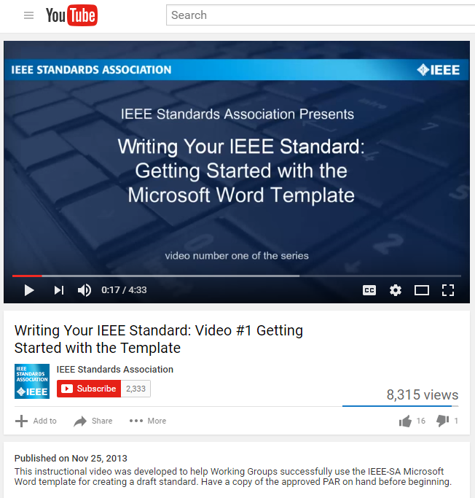
How Do I Access…
IEEE-SA training videos?
Video #1: Getting Started with the Template (for new standards)
Video #2: Composing Your Draft in
the Template (for new standards)
Video #3: Adding Figures and Tables
in the Template
Video #4: Adding Annexes, Creating
a Bibliography, and Inserting Cross-References in the Template

Slide 11
Key Features of the Template

Slide 12
Add-Ins tab > Custom Toolbars
Template toolbar inserts elements of an IEEE draft standard
Formatting toolbar applies styles to existing text in an IEEE draft standard

Slide 13
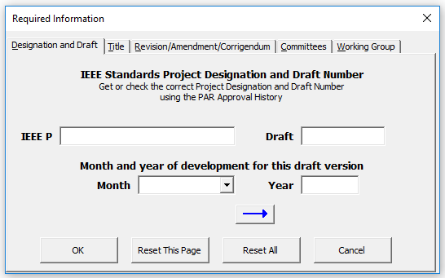
Required Information
Draft labeling, title, names of Society, Sponsor and WG, etc.
Window appears after first time opening the template, can then access on the template toolbar
Macro uses text entered to auto-populate fields within the template
    Tip #1: Click OK after entering text for each tab
    Tip #2: Type in text; do not copy and paste

Slide 14
Auto-Numbering
Clause and subclause headings*
Figures*
Tables*
Equations
Bibliographic references
*Separate macro buttons for applying these styles in the main body vs. an annex

Slide 15
Other features
Equation number can be added when inserting an equation
Landscape table can be added
Definitions can be sorted
Insert annex
TOC (insert and update) (WORD)
Cross references (WORD)

Slide 16
Initial Steps—New vs. Revision

Slide 17
Initial Steps
For new standards
  Download the latest version of the template
  Add info from approved PAR to Required Information
For revision standards, same steps as for new
PLUS
  Copy text from the “roundtrip” document
  Paste in the template

Slide 18
Tips and Tricks

Slide 19
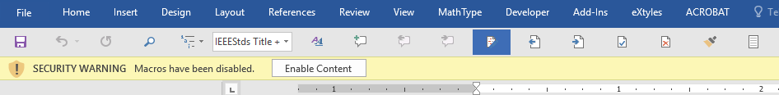
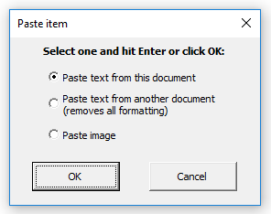
MS Word Tips and Tricks
Must enable macros in Word
Paste special (Ctrl + V)

Slide 20
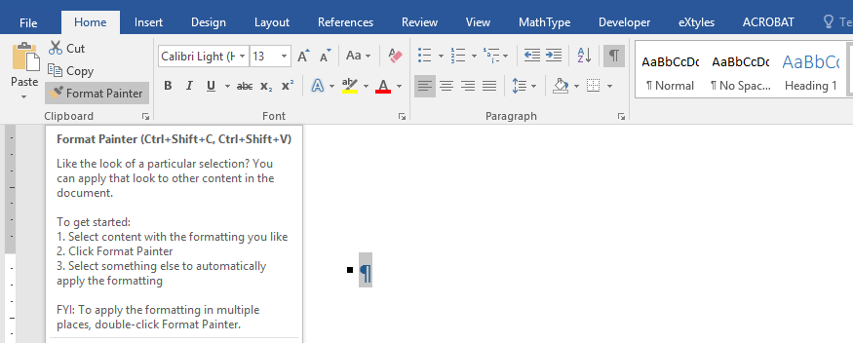
MS Word Tips and Tricks
Home tab > Format painter button

Slide 21
IEEE-SA Staff Support
Don’t spend time trouble shooting!
If something isn’t working, send Word template and description of issues via email to
sa_templates@ieee.org

Slide 22
My Contact Information
Lisa Perry
IEEE
445 Hoes Lane
Piscataway, NJ 08854
T: 732-562-3942
l.perry@ieee.org
www.standards.ieee.org

