Slide 1

Transformers Committee
Standards Report
April 2, 2017
James Graham,P.E.
Standards Coordinator
Transformers Committee

Slide 2
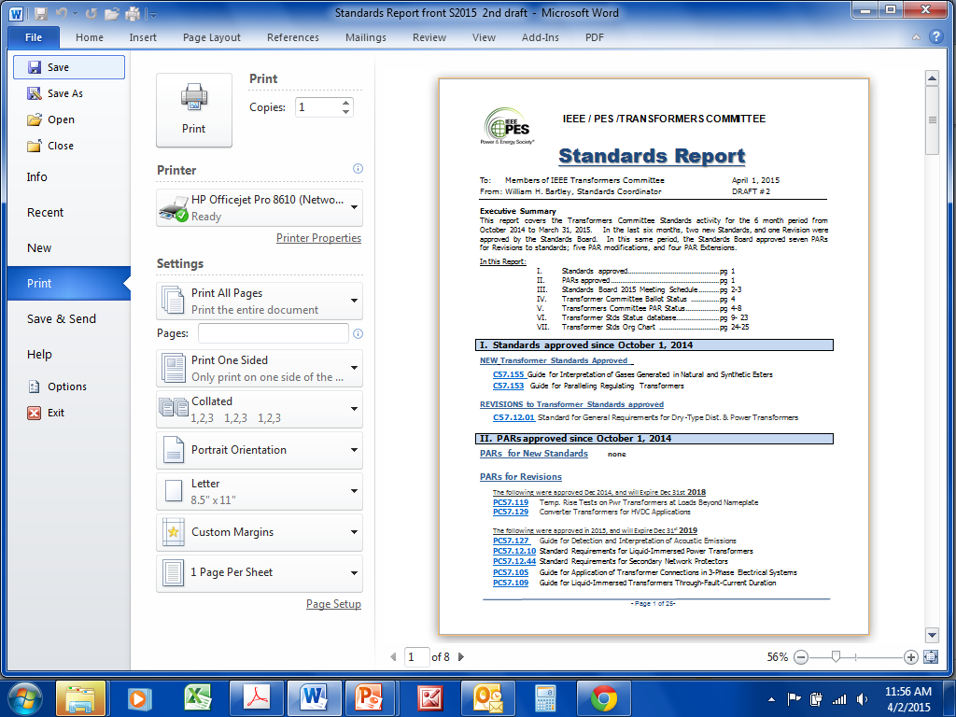
Semi-annual Status Report
  Standards approved
  PARs approved
  Ballot Status
  PARs Status
  Standards Status
  Committee Org Chart

Slide 3
Standards approved in last 6 months
NEW Standards approved – none
REVISIONS approved
C57.12.24 Standard for Submersible, Three-Phase Transformers, 3750 kVA and Smaller: High Voltage, 34 500 GrdY/19 920 Volts and Below; Low Voltage, 600 Volts and Below
C57.120 Guide for Loss Evaluation of Distribution and Power Transformers and Reactors (2017)
C57.138 Recommended Practice for Routine Impulse Test for Distribution Transformers
NOTE: Standards have a life of Ten (10) Years

Slide 4
Standards approved in last 6 months
Corrigenda approved
C57.12.38-2014 Corrigendum 1
Standard for Pad-Mounted-Type, Self-Cooled, Single-Phase Distribution Transformers 250 kVA and Smaller: High Voltage, 34 500 GrdY/19 920 V and Below; Low Voltage, 480/240 V and Below
C57.163-2014 Corrigendum 1
Guide for Establishing Power Transformer Capability while under Geomagnetic Disturbances
C57.12.90-2015 Corrigendum 1
Standard Test Code for Liquid-Immersed Distribution, Power, and Regulating Transformers
NOTE: A Corrigendum does not extend the a life of a standard.

Slide 5
PARs approved last 6 months
PARs for New Standards (approved until 31 December, 2021)
P60214-1-57-131 Standard Requirements for Tap Changers (2020)
PC57.13.9 Standard for Power-Line Carrier Coupling Capacitors and Coupling Capacitor Voltage Transformers
PC57.32a Standard for Requirements, Terminology, and Test Procedures for Neutral Grounding Devices Amendment: Neutral Grounding Resistor Section
PC57.165 Guide for Temperature Measurements for Liquid Immersed Transformers and Reactors
All PARs have a life of 4 Years

Slide 6
PARs approved last 6 months
PARs for Revisions (approved until 31 December, 2021)
P1277 Standard General Requirements and Test Code for Dry-Type and Oil-Immersed Smoothing Reactors for DC Power Transmission
PC57.12.00 Standard for General Requirements for Liquid-Immersed Distribution, Power, and Regulating Transformers
PC57.12.80 Standard Terminology for Power and Distribution Transformers
PC57.142 Guide to Describe the Occurrence and Mitigation of Switching Transients Induced by Transformers, Switching Device, and System Interaction

Slide 7
PARs approved last 6 months
PARs for Revisions (approved until 31 December, 2021)
PC57.143 Guide for Application of Monitoring Equipment to Liquid-Immersed Transformers and Components
PC57.150 Guide for the Transportation of Transformers and Reactors Rated 10,000 kVA or Higher
PAR Modifications approved – None
PARs for Corrigenda approved – None

Slide 8
PARs approved last 6 months
PAR Extensions approved (extended until 31 Dec, 2017)
P1276 Guide for the Application of High-Temperature Insulation Materials in Liquid-Immersed Power Transformers (2018)
PC57.12.20 Standard for Power Transformers - Part 16: Transformers for Wind Turbine Application (2017)
PC57.12.39 Standard Requirements for Distribution Transformer Tank Pressure Coordination (2017)
PC57.13.7 Standard for Current Transformers with a Maximum mA Secondary Current of 250 mA (2017)
PC57.120 IEEE Loss Evaluation Guide for Power Transformers and Reactors (2017)
PC57.158 Guide for the Application of Tertiary and Stabilizing Windings in Power Transformers (2018)

Slide 9
Expiration Dates
PARs have a four year life cycle, from the calendar year of Standards Board approval.
A PAR approved in January 2017 expires December 31, 2021.
A PAR approved in December 2017 expires December 31, 2021.
Standards have a Ten Year life cycle from the Standards Board approval date.
Example: C57.12.60 Approved 11/9/2009
Expires 11/9/ 2019

Slide 10
2017 Standards Board Deadlines
Stds. Board Meeting | Submission Deadline
May 2017 (teleconference) | March 24th 2017
June 2017 | May 5th, 2017
September 2017 (teleconference) | July 28th, 2017
December 2017 | October 16th, 2017

Slide 11
Submission Deadline for the last Standards Board meeting in 2017 is Monday,
October 16th 2017

Slide 12
Committee Ballot Status
(refer to page 3 of the standards report)
As of 24 March, 2017
3 standards are in ballot
11 standards are in comment resolution

Slide 13
Status - Active PARs
( refer to page 5 if the standards report)
55 Active PARS
13 PARs expire December 31, 2017
Draft Development - 5
In Ballot - 2
In Comment Resolution - 5
On RevCom Agenda - 1

Slide 14
Status - Active PARs
( refer to page 5 if the standards report)
55 Active PARS
13 PARs expire December 31, 2018
Draft Development - 7
In Ballot - 0
In Comment Resolution - 6
On RevCom Agenda - 0

Slide 15
Status - Active PARs
( refer to page 5 if the standards report)
55 Active PARS
9 PARs expire December 31, 2019
Draft Development - 7
In Ballot - 1
In Comment Resolution - 1
On RevCom Agenda - 0

Slide 16
Status - Active PARs
( refer to page 5 if the standards report)
55 Active PARS
11 PARs expire December 31, 2020
Draft Development - 10
In Ballot - 0
In Comment Resolution - 0
On RevCom Agenda - 1

Slide 17
Status - Active PARs
( refer to page 5 if the standards report)
55 Active PARS
9 PARs expire December 31, 2021
Draft Development - 9
In Ballot - 0
In Comment Resolution - 0
On RevCom Agenda - 0

Slide 18
Status – Standards
(refer to page 9 of the standards report)
20 Standards expire in 2018
19 standards have active PARs
1 standard has no active PAR
8 Standards expire in 2019
5 standards have active PARs
3 standards have no active PARS
13 Standards expire in 2020
4 standards have active PARs
9 standards have no active PARS

Slide 19

Monday Standards Luncheon
All are Welcome !!
IEEE Standards Template
Lisa Perry, IEEE Senior Program Manager
Content Production & Management

Slide 20
Organization Chart
A revised organization chart has been posted
New multi-page letter-size format
Completed task forces removed
New working group chairs

Slide 21

Questions?
      James Graham, P.E.
      Transformers Committee
      Standards Coordinator
      Email: jimgraham@ieee.org
Notes:
21

