Slide 1
Transformers Committee
Recognition & Awards Luncheon
Stephen Antosz, Awards Chair
Pittsburgh, PA
March 27, 2018

Slide 2
Tribute to Our Lost Friends

Slide 3
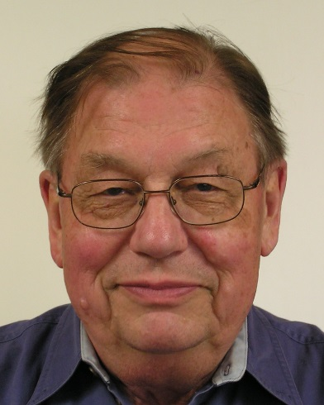
In Memoriam:
Stan Lindgren

Slide 4
In Memoriam:
Stan Lindgren
Stanley (Stan) Roland Lindgren passed away peacefully on December 17, 2017. He graduated from Kansas State College in early 1950 with a Bachelor of Science in Electrical Engineering. Stan began his career with Allis Chalmers (A-C) in West Allis, Wisconsin in 1950. He credited much of his power transformer knowledge to his mentor, L.S. Woodruff (Woodie) who designed A-C’s first transformer in 1903. Stan went on to work for RTE in Waukesha, Wisconsin; Paragon AMF in Manitowoc, Wisconsin; EPRI in Palo Alto, California and concluded his 62-year career in 2012 while working for Serveron Corp. in Portland, Oregon. He was a lifetime member of IEEE and a recognized power transformer expert. Stan was preceded in death by his wife of 60 years Caroline. He leaves behind two sons, Eric and Carl, and one daughter, Joanne, and their families.

Slide 5
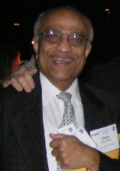
In Memoriam:
Sam Mehta

Slide 6
In Memoriam:
Sam Mehta
Shirish “Sam” Mehta passed away unexpectedly on January 30, 2018 while traveling in India. Sam had many different roles in his 44-year tenure with SPX Waukesha and its predecessors that began in 1970. Sam was the VP of Research and Technology when he retired and continued to work in the industry after retirement. Sam was always smiling and willing to take time to teach anyone that wanted to learn. According to Tom Prevost: “Sam was an old-school "Transformer Guy" who lived his life in (and for) the transformer industry. He was a mentor and a friend to me and I'm sure many others."
Sam got an award for Outstanding Paper in Fall 2017, as a co-author. Temperature Rise Tests on a Forced-Oil-Air Cooled (FOA) (OFAF) Core Form Transformer, Including Loading Beyond Nameplate by M. V. Thaden, Subhash Tuli, Sam Mehta, and R. L. Grubb

Slide 7
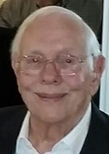
In Memoriam:
Frank W. Heinrichs Jr.

Slide 8
In Memoriam:
Frank W. Heinrichs Jr.
Frank was 88 when he died Aug. 16, 2016. Frank was a graduate of Carnegie Technical Institute (Carnegie Mellon University). He developed his transformer expertise with McGraw Edison/Cooper Industries at Canonsburg, PA, where he pursued his career as an Electrical Engineer, retiring as Chief Engineer and was involved in numerous patents. Frank was an active member of the Transformers Committee for many years, and was Chair of C57.104 & C57.130 WGs in the Insulating Fluids SC. Frank was a U.S. Marine Corp Veteran. Frank was active in his church, was a lector, Eucharistic minister and Sunday school teacher. He loved reading, sculpture, painting, being outdoors with nature, golf, fishing, playing bridge and spending time at the ocean. Most of all, he loved being with his loving family and dear grandchildren

Slide 9
General Service Awards
Transition Slide
After some emotional moments, let’s change the mood back to something funny, for 1 minute…
IEEE Trans Comm Celebrity Look alikes

Slide 10
General Service Awards
Meeting Host – Dennis Blake & Team at Pennsylvania Transformer Technologies

Slide 11
General Service Awards
Outgoing Officers:
Committee Chair – Stephen Antosz
Committee Treasurer – Greg Anderson
Past-Chair – Don Platts,
  Recognition & Awards Subcommittee

Slide 12
General Service Awards
Outgoing Subcommittee Chairs:
Greg Anderson, Meetings Planning SC
Bill Bartley, Standards SC
Bruce Forsyth, Insulation Life SC
Ed teNyenhuis, PerformanceCharacteristics
Joe Watson, Power Transformers SC

Slide 13
New Committee Members

Slide 15
New Committee Members
Myron Bell Delta Star
Jermaine Clonts Power Partners
James Dorsten Alabama Power
Hugo Flores WEG Transformers USA
Rakesh Rathi Virginia Transformer
Pugazhenthi Selvaraj Virginia Transformer
Alwyn VanderWalt Pub Serv Comp New Mexico
David Walker MGM Transformer Company

Slide 16
Awards for WG Completion and Publication of Document

Slide 17
C57.120 Guide for Loss Evaluation of Distribution and Power Transformers and Reactors
Working Group Chair – Rogerio Verdolin
Significant Contributors:
Rod Sauls, Vice-Chair
Wally Binder Don Duckett
Dave Harris Michael Miller
Al Traut

Slide 18
60076-57-129 Standard for General Requirements and Test Code for Oil-Immersed HVDC Converter Transformers
Working Group Chair - Ulf Radbrandt
Significant Contributors:
Sheila Batey Eric Davis Fred Elliot
Paul Jarman Ugo Piovan Christoph Ploetner
Pierre Riffon Michael Sharp Yukiyasu Shirasaka
Giovanni Testin Frank Trautmann Jian Wang
Waldemar Ziomek

Slide 19
C57.106 Guide for Acceptance and Maintenance of Insulating Mineral Oil in Electrical Equipment
Working Group Chair – Bob Rasor
James Thompson,Vice-Chair. Claude Beauchemin,Secretary
Paul Boman
Juan Castellanos
Don Cherry
Clair Claiborne
Stephanie Denzer
Don Dorris
Shawn Galbraith
James Gardner
Dave Hanson
Roger Hayes
Zan Kiparizoski
Tom Melle
Chris Miano
Hali Moleski
Arturo Nunez
Luke Parthemor
Nick Perjanik
Alan Peterson
Don Platts
Tom Prevost
Jimmy Rasco
Oleg Roizman
Ryan Thompson

Slide 20
C57.12.20 Standard for Overhead-Type Distribution Transformers 500 kVA and Smaller: High Voltage, 34 500 V and Below; Low Voltage, 7970/13 800Y V and Below
Working Group Chair – Alan Traut
Significant Contributors:

Slide 21
Awards for WG Completion

Slide 22
Awards Distribution Form from IEEE-SA

Slide 23
The End

